Slide 1

Preliminary 2026 Pacific Salmon Outlook

Slide 2
INTRODUCTION
Purpose of the Outlook
Provide expected salmon abundance for 2026 to Inform harvest planning and management decisions
Combine categorical abundance based on expert opinion and statistical forecast, where available

Slide 3
INTRODUCTION
Contributors
Stock assessment biologists across the Region
Collaborative programs with First Nations
Other stakeholders and stewardship groups

Slide 4
INTRODUCTION
How Outlooks Are Defined
By Stock Management Unit (SMU)
By Conservation Unit (CU), if data available
Biological and management reference points are used to assign Outlook category, where available
SMUs without references have categorical Outlooks assigned based on expert opinion

Slide 5
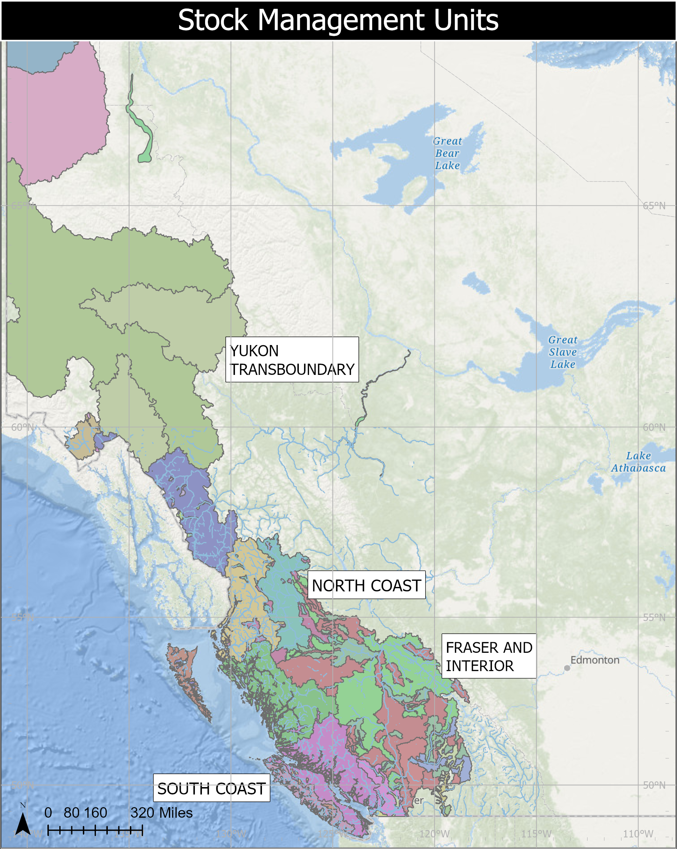
INTRODUCTION
Stock Management Units
What is an SMU?
A group of one or more Conservation Units (CUs) managed together
Harvest rules usually apply to the aggregate
Why use SMUs?
Practical grouping of CUs for harvest planning and reporting
Basis for Integrated Fisheries Management Plans (IFMPs)
Important Notes
CU-level diversity still considered
Precautionary Approach often applied within SMUs
Notes:
Need to update map. Maybe colour by Area. Change projection.

Slide 6
INTRODUCTION
Biological and Management References
Biological benchmarks and limit references points
The SMU or CU is assessed against specified limits and targets (defined by the Wild Salmon Policy and Precautionary Approach)
Pre-defined harvest strategies are in place that define the actions required to meet targets and avoid limits.
Current gap
Many stocks lack defined references
Work is ongoing to develop methods and complete analyses to define these references

Slide 7
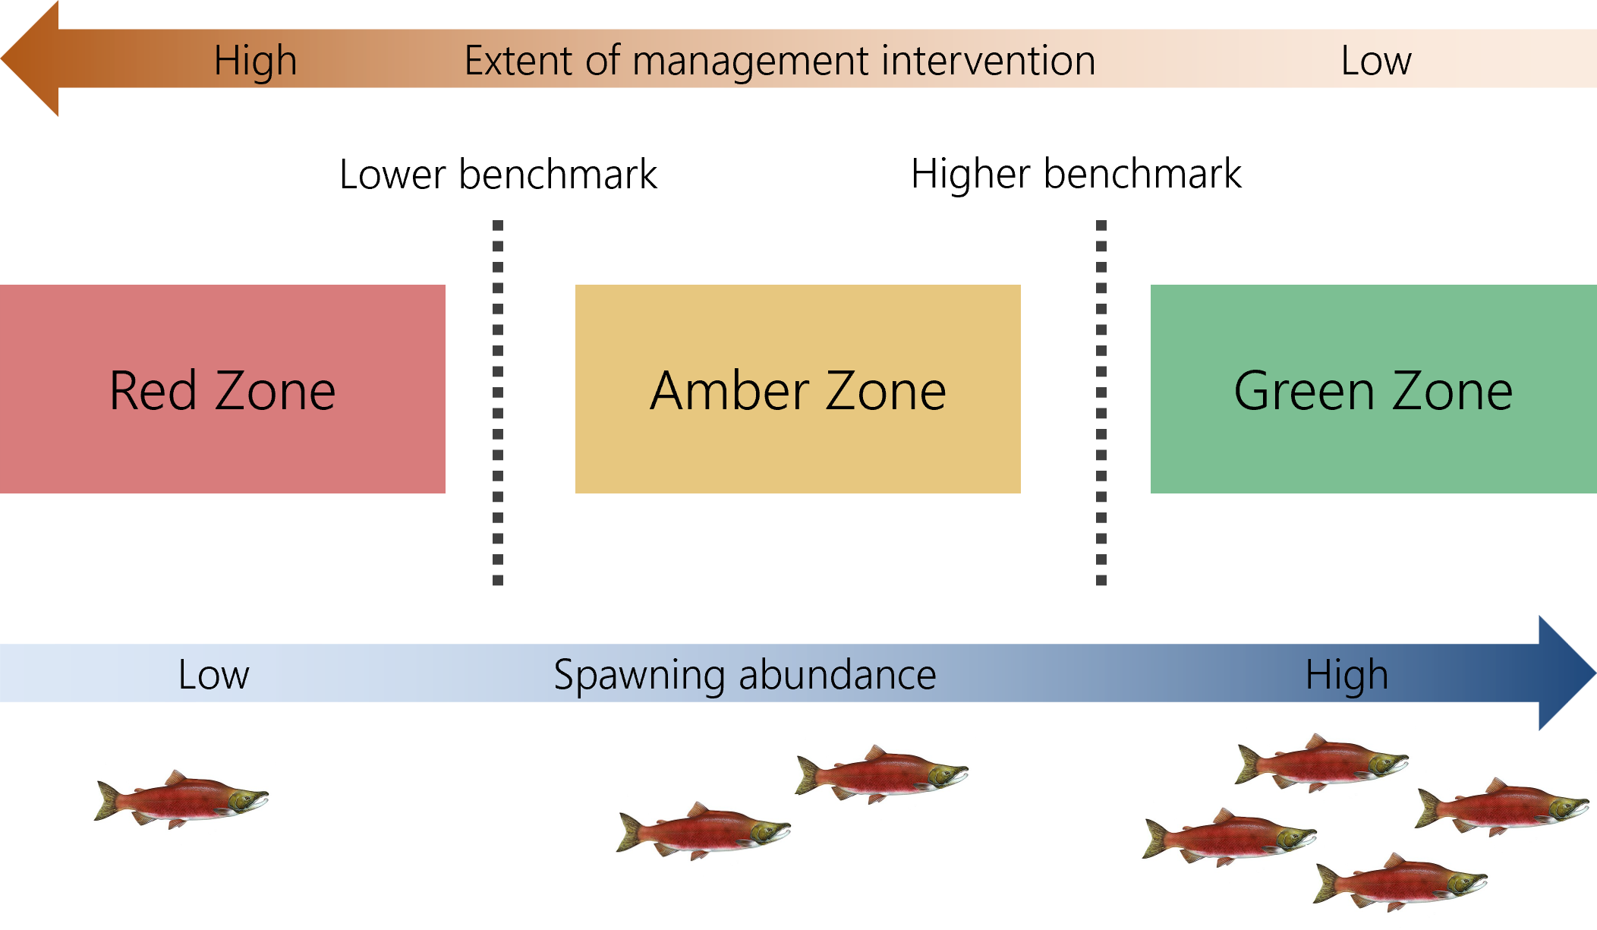
INTRODUCTION
Wild Salmon Policy Benchmarks
CU-level assessment under WSP
CUs are assessed against biological benchmarks
Benchmarks indicate significant changes in production status
Zones and management response
Red: Low abundance ➔ high intervention
Amber: Moderate abundance ➔ caution
Green: High abundance ➔ low intervention
Benchmarks and zones under the Wild Salmon Policy (DFO, 2005)
Notes:
The lower biological benchmark allows for substantial buffer between it and the level of abundance at which the stock would be considered at risk of extinction
The higher biological benchmark delineates the ‘amber’ from ‘green’ WSP status zone

Slide 8
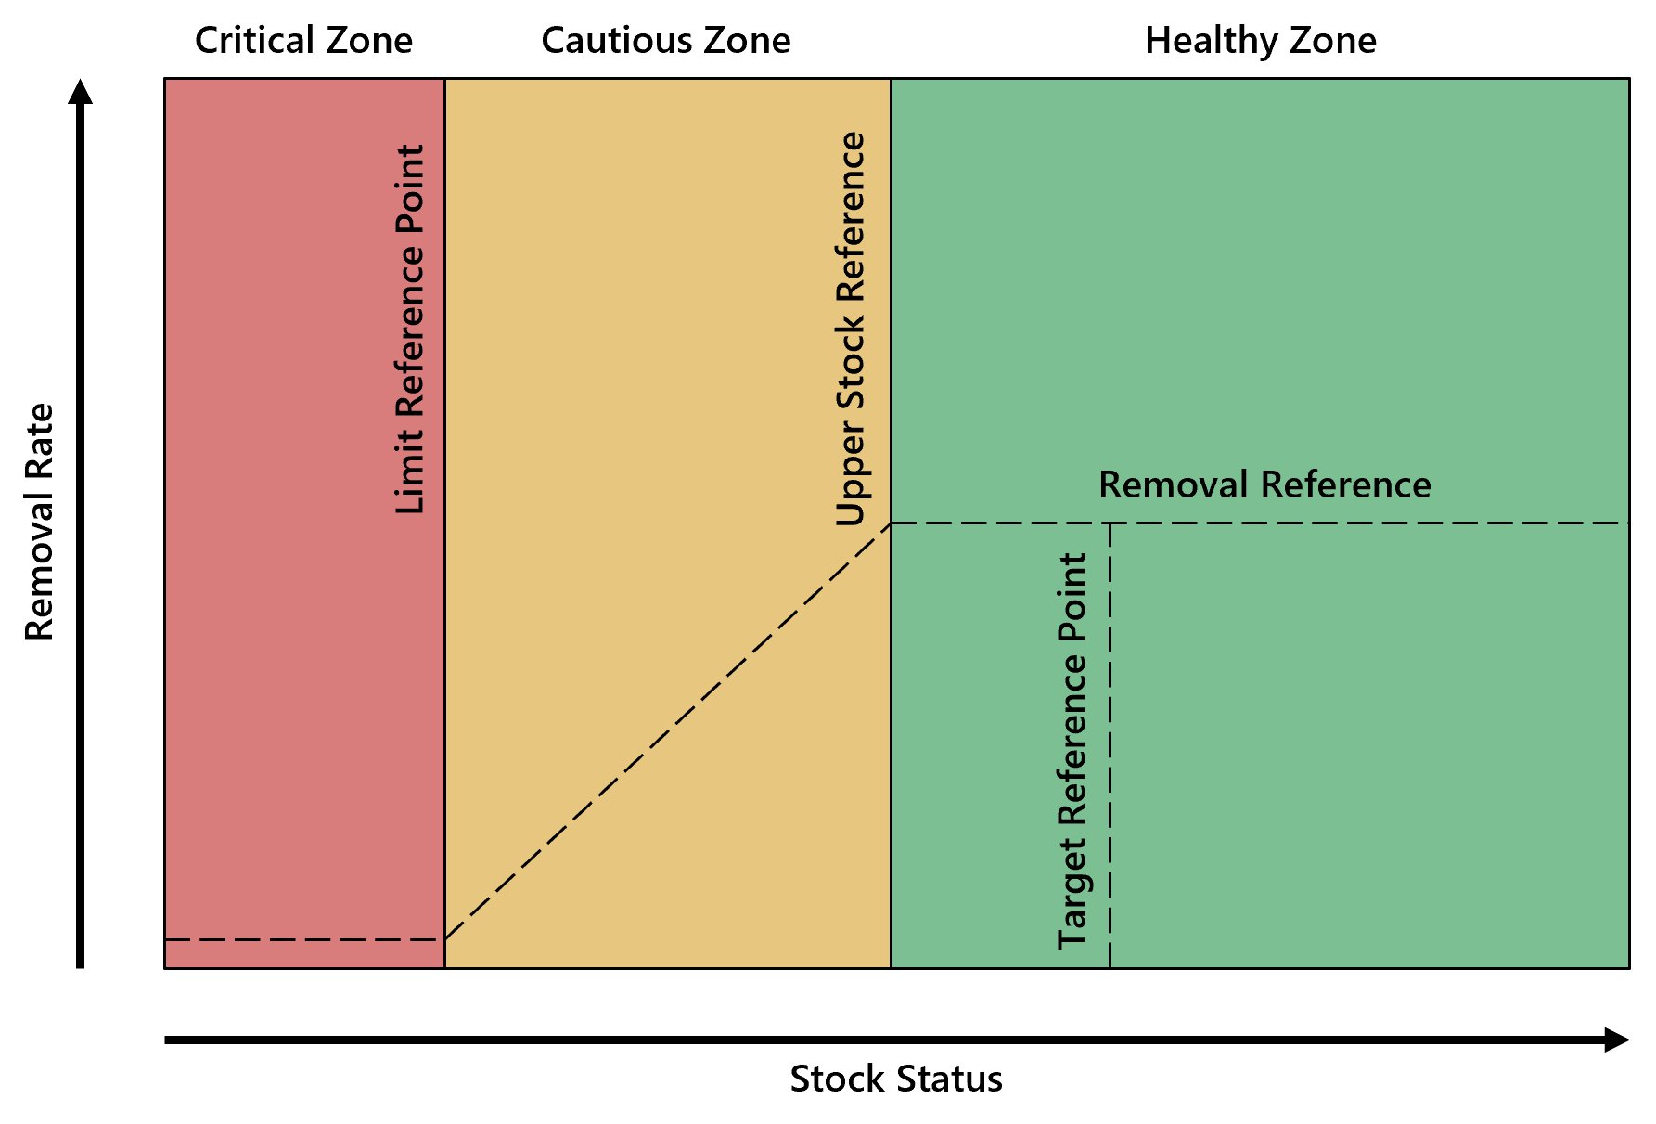
INTRODUCTION
Precautionary Approach
For SMUs: harvest decisions use limit reference points
Limit reference point (LRP) = critical harvest threshold
Below LRP ➔ major stock and ecosystem risk
Methods for defining LRPs vary by data availability
DFO’s precautionary principal

Slide 9
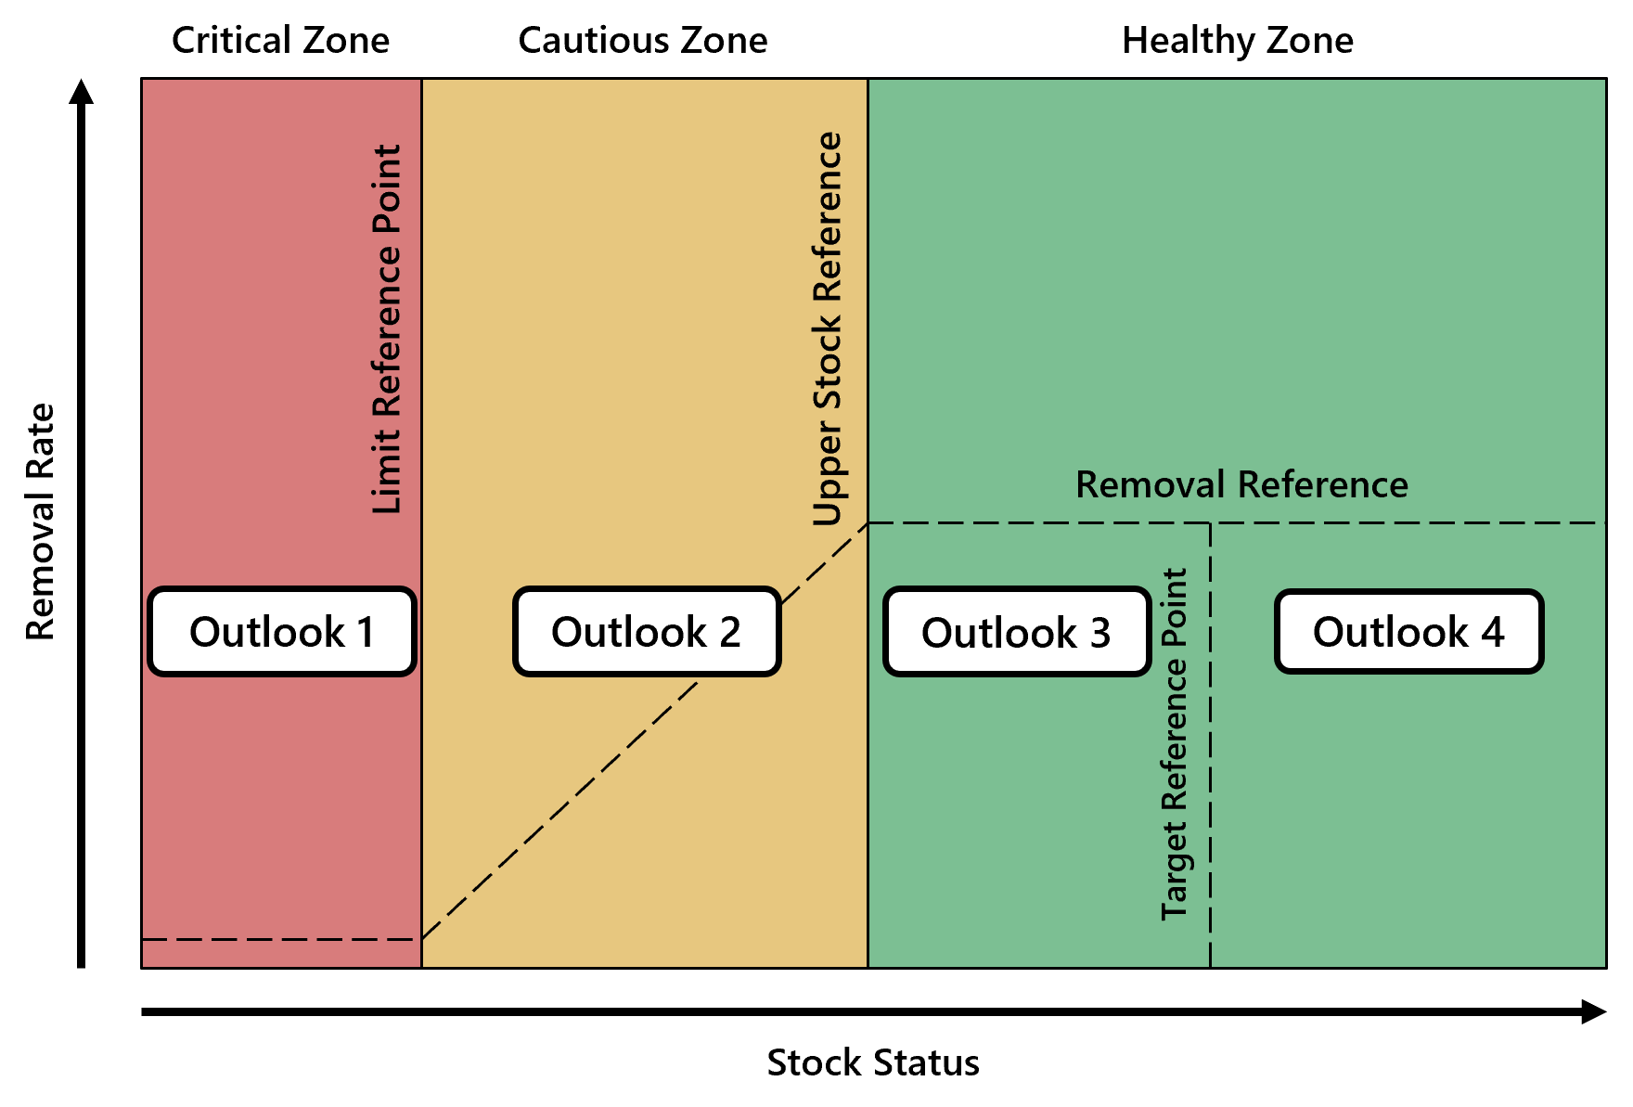
INTRODUCTION
Outlook Categories: Combining Approaches
Outlook Category | CUs or SMUs with references |  |  | Data-Limited CUs or SMUs
 | Wild Salmon Policy (CU Level) | Precautionary Approach (SMU Level) |  | Category Definition | Expected spawning abundance (percentile)
1 | Red Zone | Critical Zone |  | Well below average | <25
2 | Amber Zone | Cautious Zone |  | Below average | 25–40
3 | Green Zone | Healthy Zone |  | Near average | 40–60
4 | Green Zone | Healthy Zone |  | Abundant | >60
Data Deficient | - | - |  | Insufficient information | Unknown

Slide 10
CONCLUSION
Access Previous & Upcoming Outlooks
2024 Final Outlook
Pacific Salmon Outlook, Pacific Region 2024 (PDF)
2025 Final Outlook
Pacific Salmon Outlook, Pacific Region 2025 (PDF)
The final 2026 Outlook will be posted on the DFO Library once forecasts are completed
The SMU-CU-DU Crosswalk is available on GitHub

